Slide 1
Typical Enterprise IT Network
Chapter 2:
Typical Enterprise IT Architecture & Security Overlay

Slide 2
Typical Enterprise IT Network
What does a typical enterprise IT network look like ?

Slide 3
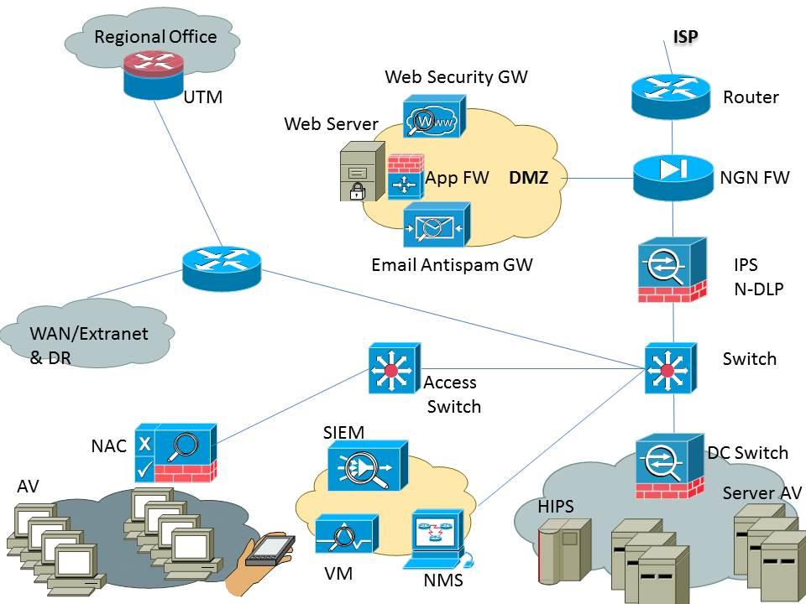
Typical Enterprise IT Network

Slide 4
Typical Enterprise IT Network
Edge router
NGN FW
DMZ:
Web security GW/Proxy
Application security FW
Web server
Email antispam GW
IPS & N-DLP
Distribution switch

Slide 5
Typical Enterprise IT Network
Data center switch & FW
Access switch
NAC
SOC:
SIEM
VM
Other SOC tools
System AV
Server HIPS
UTM
Mobile device - MDM

